Slide 1
eSign
Be part of the game.

Slide 3


Slide 4
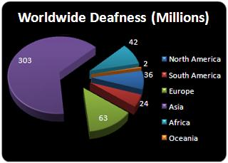


Slide 5


Slide 6
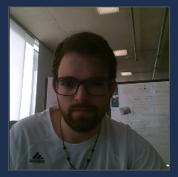





Architecture of the system

Slide 7




Slide 9


